Slide 1
Importing CSV
Make sure all currency values are in Euros to two decimal places. All dates to appear in the medium format: DD/MMM/YYYY Using a suitable database package, import the file footballplayers.CSV Use appropriate data types Set the Ranking as the key field.
Import the file clubs.CSV as a new table in your database. Use appropriate data types Set the Club as the key field.
Create the appropriate one to many relationship using the key fields: Identify the primary and foreign keys which will be used.

Slide 2
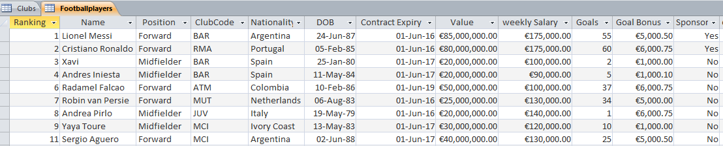
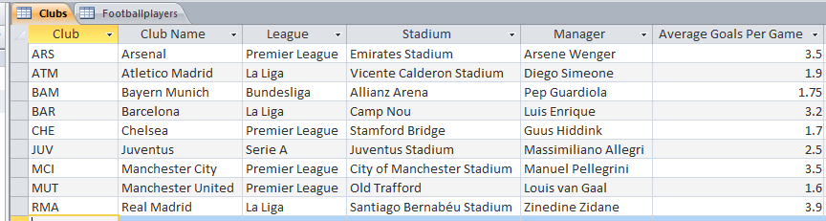

Slide 3
Query and Report
Produce a report which: Contains a new field called Final_Bonus which is calculated at run-time. The goals and goals bonus fields need to be multiplied. Shows only the records where: Player are born between 1984 and 1990 Midfield or Forward Players Excludes nationalities from Brazil, France and England Scored 10 goals or more Contract Expires after 01/01/2017 Shows only the fields Name, Club Name, League, Goals and Final_Bonus Fits on a single page wide and has page orientation of Portrait Sorts the data into ascending order of goals scored Calculates the average of the final bonus field. Include an appropriate label and place it at the bottom of the report. Includes the heading End of Season Bonus at the top of the page Has your name on the right in the report footer.

Slide 4
Query and Report
Produce a report which: Contains a new field called NewValue which is calculated at run-time. 45% needs to be taken from the current player valuation. Shows only the records where: Players contracts are expiring in June 2016 Shows only the fields Name, Club Name, Value, NewValue, League and Manager Fits on a single page wide and has page orientation of Landscape Sorts the data into ascending order of NewValue. Calculates the average of the NewValue and Value Fields for all players. Include an appropriate label and place it at the bottom of the report. Includes the heading Contracts Expiring at the top of the page Has your name on the right in the report footer.

Slide 5
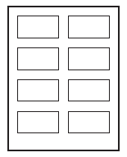
Label
You are going to prepare labels for some Premiership players. Produce labels from all the data which: Arrange labels in two columns. Only include players from the premiership who where born in either April or May. Show only the fields Name, ClubName, League and DOB on a separate line. Display the field name as well as the data In a larger font, at the top of each label, include the heading: Premiership players Include your name at the bottom of each label.

Slide 6
Summery Queries
Show only the Club Name and Goals Calculates the total value of goals scored for each club. Counts the number of players who have scored for each club.
Extract the summery Query into a Word Document as table.
Create a bar chart showing the number of goals scored for each club. Include suitable titles for the bar chart and the axis. Do not show the legend.
Extension: Make a query showing all the forward players. Using these records create a summery query: Show only the Nationality and Goals Calculates the total number of goals scored for each nationality. Counts the number of players who have scored for each nationality. Create a bar chart showing the number of games for each platform. Include suitable titles for the bar chart and the axis.

